Slide 1
Chapter One
0
Organizations and
Organization Theory

Slide 2
Organization Theory in Action
0
Organization theory helps us explain what happened in the past, as well as what may happen in the future, so that we can manage organizations more effectively.

Slide 3
Framework for the Book
0
Examine specific characteristics of organizations
Examine the nature of and relationships among groups and departments
Organizational behavior is the micro approach
Organization theory is the macro examination
Meso theory is the integration of both the macro and micro which is the approach of this text

Slide 4
Structure of Book
Part 1: INTRODUCTION TO ORGANIZATION
CHAPTER 1
Organizations and Organization Theory
Part 2: ORGANIZATIONAL PURPOSE and STRUCTURAL DESIGN
CHAPTER 2
Strategy, Organization Design and Effectiveness
CHAPTER 3
Fundamentals of Organization Structure

Slide 5
Structure of Book
Part 3: OPEN SYSTEM DESIGN ELEMENTS
CHAPTER 4
The External Environment
CHAPTER 5
Interorganizational Relationships
CHAPTER 6
Design Organizations for the international Environment

Slide 6
Structure of Book
Part 4: INTERNAL DESIGN ELEMENTS
CHAPTER 7
Manufacturing and Service Technologies
CHAPTER 8
Using Information Technology for Control and Coordination
CHAPTER 9
Organizational Size, Life Cycle and Decline

Slide 7
Structure of Book
Part 5: MANAGING DYNAMIC PROCESSES
CHAPTER 10
Organizational Culture and Ethical Values
CHAPTER 11
Innovation and Change
CHAPTER 12
Decision Making Processes
CHAPTER 13
Conflict, Power and Politics

Slide 8
EXAM
Exam consisting of 8 learning test sections assessing knowledge and understanding of the Organization Theory and Design topics.
Each section, not more than 25 minutes, will be independently graded
Threshold to pass is 18/30 an maximum Mark is 30/30.
The final mark is obtained as the average of marks given to each section of the written exam: 0,25 rounded to the superior number

Slide 9
LEARNING TEST
Each Test consists of 30 multiple choice questions with 4 possible alternatives.
Each correct answer adds 1 point, for each wrong answer you take off a point, if you do not answer the score remains unchanged.
In some Tests some questions are replaced by twice as many statements that require you to indicate as a true/false answer. For true/false answers you add or subtract 0.5.

Slide 10
SECTION OF LEARNING TESTS
LEARNING TEST 1: Chapter 1 and 2
LEARNING TEST 2: Chapter 3
LEARNING TEST 3: Chapter 4, 5 and 6
LEARNING TEST 4: Chapter 7
LEARNING TEST 5: Chapter 8
LEARNING TEST 6: Chapter 9 and 10
LEARNING TEST 7: Chapter 11
LEARNING TEST 8: Chapter 12 and 13

Slide 11
ORGANIZATIONAL PROBLEM
The organization is the result of the division of labor that creates specialized activities.
First Industrial Revolution (second half of the Eighteenth Century): the principles of division of labor and specialization are applied in extended measurement to manufacturing supplanting the shapes craft.
Second Industrial Revolution (beginning of the Twentieth Century): the Scientific Organization of Labor (Taylor), gave rise to a second industrial revolution with the birth of mass production.

Slide 12
ORGANIZATIONAL PROBLEM
Specialized activities allow you to access:
Economies of specialization, permitted by machines and production units dedicated;
Economies of learning, as the operator, by limiting its cognitive orientation to a small range of operations manages to learn more quickly through the repetition;
Economies of scale production, since the specialized installations may take significant dimensions and such to achieve lower unit costs, thanks to the distribution of fixed costs on a higher production.

Slide 13
ORGANIZATIONAL PROBLEM
The specialized activities must be reduced through the Coordination to the unit, which was broken by the division of work.
More widespread the specialization, more important and complex the role of Coordination.
The Coordination is the essence of the Organization and the various organizational solutions differ in how the realize the coordination.

Slide 14
ORGANIZATIONAL PROBLEM
The FIRST form of Coordination is the market.
The MARKET, through the PRICE MECHANISM, coordinates the activities of specialized producers.
The market in this perspective, it is the more efficient structure of coordination because it operates with a single information: the PRICE
The SECOND form of Coordination is represented by the HIERARCHY.
The MANAGEMENT coordinates and returns to the unit the specialized activities collected in the internal organization

Slide 15
What is an Organization?
0
Social entities that are goal-directed
Designed as deliberately structured and coordinated activity systems
Linked to the external environment
Includes large multinational corporations, family owned businesses as well as nonprofits

Slide 16
Importance of Organizations
0
Bring together resources to achieve desired goals and outcomes
Produce goods and services efficiently
Facilitate innovation
Use modern manufacturing and information technologies
Adapt to and influence a changing environment
Create value for owners, customers and employees
Accommodate ongoing challenges of diversity, ethics, and the motivation and coordination of employees

Slide 17
ORGANIZATIONS AS OPEN SYSTEMS
AN OPEN SYSTEM IS:
A set of interacting elements that acquires inputs from the environment, transforms them and discharges outputs to the outside environment
Composed of multiple subsystems that perform specific functions required for the survival of the organization
Open systems must interact with the environment to survive.
Subsystems perform functions such as production, boundary spanning, maintenance, adaptation, and management.

Slide 18
An Open System and Its Subsystems
Environment
Transformation
Process
Raw Materials
People
Information
resources
Financial
resources
Products
and
Services
Input
Output
Production,
Maintenance,
Adaptation,
Management
Subsystems
Boundary
Spanning
Boundary
Spanning

Slide 19
DIMENSIONS OF ORGANIZATIONS DESIGN
The first step for understanding organizations is to look at dimensions that describe specific organizational design traits.
Structural dimensions provide labels to describe an organization’s internal characteristics.
Contextual dimensions characterize the whole organization and describe the organizational setting
To understand and evaluate the organizations is necessary to consider both dimensions.

Slide 20
Dimensions of
Organization Design
0
Structural Dimensions
  Formalization
  Specialization
  Hierarchy of authority
  Centralization
  Professionalism
  Personnel Ratios
Contextual Dimensions
  Size
  Organizational technology
  Environment
  Goals and strategy
  Culture

Slide 21
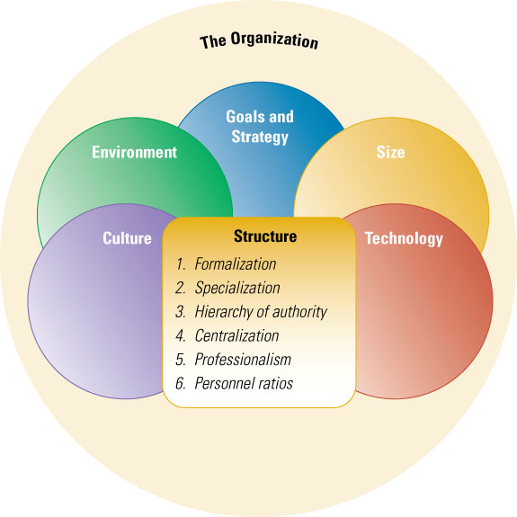
Interacting Contextual and Structural Dimensions of Organization Design
0

Slide 22
STRUCTURAL DIMENSIONS
The structural dimensions provide labels to describe the internal characteristics of an organization; they create a basis for measuring and comparing the organizations.
1. FORMALIZATION:
Formalization pertains to the amount of written documentation in the organization.
Documentation includes procedures, job descriptions, regulations and policy manuals.
These written documents describe behavior and activities.

Slide 23
STRUCTURAL DIMENSIONS
2. SPECIALIZATION:
Specialization is the degree to which organizational tasks are subdivided into separate jobs.
If specialization is extensive, each employee performs only a narrow range of tasks.
3. HIERARCHY of AUTHORITY:
Hierarchy of authority describes who reports to whom and the span of control.
The hierarchy is depicted by the vertical lines on an organization chart.
The hierarchy is related to the span of control (the number of employees reporting to the supervisor).

Slide 24
STRUCTURAL DIMENSIONS
4. CENTRALIZATION:
Centralization refers to the hierarchical level that has authority to make a decision.
When decision making is kept at the top level, the organization is centralized.
5. PROFESSIONALISM:
Professionalism is the level of formal education and training of employees.
6. INDICES OF STAFF:
Refer to the use of persons in the various functions and departments.

Slide 25
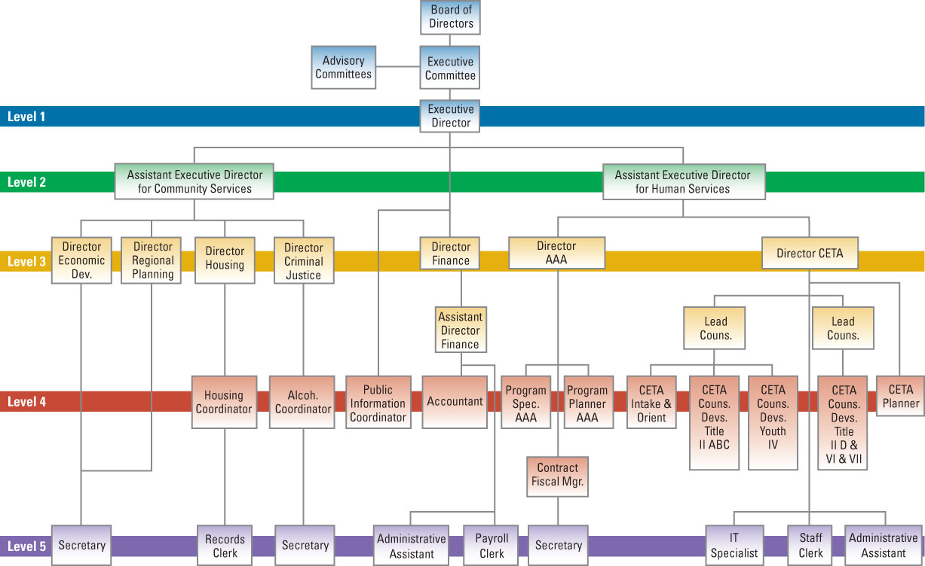
Organization Chart
0

Slide 26
CONTEXTUAL DIMENSIONS
The contextual dimensions characterize the entire organization; they describe the organizational environment that influences and shapes the structural dimensions
SIZE:
Size is the organization's magnitude.
Because organizations are social systems, seize is typically measured by the number of employees.
Other measures as total sales or total assets also reflected magnitude but they do not indicated the size of the human part of the system.

Slide 27
CONTEXTUAL DIMENSIONS
TECHNOLOGY:
Organizational technology refers to the tools, techniques, and actions used to transform inputs into outputs.
It concerns how the organization actually produces the products or services, it provides for customers and includes such things as flexible manufacturing, advanced information systems, and the Internet.
ENVIRONMENT:
The environment comprises all the elements outside the boundaries of the organization.

Slide 28
CONTEXTUAL DIMENSIONS
GOALS AND STRATEGY:
Goals and strategy define the purpose and competitive techniques that set it apart from other organizations. Goals are often written down as an enduring statement of company intent.
A strategy is the plan of action that describes resource allocation and activities for dealing whit the environment and for reaching the organization’s goals.
Goals and strategies define the scope of operations and the relationship with employees, customers, and competitors.

Slide 29
CONTEXTUAL DIMENSIONS
CULTURE:
Culture is the underlying set of key values, beliefs, understandings, and norms shared by employees.
These underlying values and norms may pertain to ethical behavior, commitment to employees, efficiency, or customer service, and they provide the glue to hold organization members together.
An organization’s culture is unwritten

Slide 30
Performance and
Effectiveness Outcomes
0
The organization must learn to be:
EFFICIENT - using the least amount of resources to achieve its goals (EFFICIENCY);
EFFECTIVE - the degree to which an organization actually achieves its goals (EFFECTIVENESS).

Slide 31
The Evolution of Organization Theory and Design
0
Historical perspectives provide insight into how organization design and management practices have varied over time in response to changes in society.

Slide 32
Historical Perspectives
0
Organization theory is a way of thinking about organizations and how people and resources accomplish a specific purpose.
Organization theory is a way to see and analyze organization more accurately and deeply than one otherwise could.
The way to see and think about organization is based on patterns and regularities in organizational design and behavior.
The organizational design and managerial practices have changed radically over time in response to the changes in society.

Slide 33
Evolution of Organization Theory and Design
MAX WEBER (1864 - 1920) is the founder of the Organizational Theory with his studies on the relationship between economy, society, capitalism.
Bureaucracy was an effective approach for the needs of the Industrial Age.
Designing and managing organizations on an impersonal, rational basis as:
clearly defined authority and responsibility;
formal recordkeeping,
uniform application of standard rules.
It remained the primary approach to organization design through the 1980s.

Slide 34
Evolution of Organization Theory and Design
The SCIENTIFIC MANAGEMENT pioneered by Frederick Taylor (mechanistic-rational approach) postulates that decisions concerning the organization of work should be based on scientific studies.
He emphasize that decisions based on the rules of thumb and tradition should be replaced whit precise procedures developed after careful study of individual situations.

Slide 35
Evolution of Organization Theory and Design
To use this approach, managers develop precise, standard procedures for doing each job, selected workers whit appropriate abilities, train workers in the standard procedures, carefully plan work, and provide wage incentives to increase output.
Scientific Management focused primarily on the technical core on work performed on the shop floor.
The role of management is to maintain stability and efficiency, whit top management doing the thinking and workers doing what they are told.

Slide 36
Evolution of Organization Theory and Design
Administrative principles focused on the total organization based on insights of practitioners.
Fayol proposed fourteen principles as management, such as:
“ each subordinate receives orders from only one superior” (unit of command);
“similar activities in an organization should be grouped together under one manager” (unit of direction).
These principles formed the foundation for modern management practice and organization design.”

Slide 37
Evolution of Organization Theory and Design
HUMAN RELATIONS - BEHAVIORAL APPROCHES
The EXPERIMENTS OF HAWTHORNE (MAYO): ducts in the years '1930 from Mayo and his collaborators on the relationship between lighting and productivity.
The results of these experiments allowed him to say that a better psychological relationship with workers leads to an increase of motivation and productivity.
The publications of these findings led to a revolution in worker treatment and laid the groundwork for examining treatment of workers, leadership, motivation and human resource management.

Slide 38
Evolution of Organization Theory and Design
IT ALL DEPENDS: KEY CONTINGENCIES
Contingency theory means that one thing depends upon other things, and for organizations to be effective, there must be a fit between the structure and the conditions in the external environment.
What works in one setting may not work in another setting.
There is not one best way to manage.
Contingency theory means it depends.
The correct management approach is contingent on the organization’s situation.

Slide 39
Evolution of Organization Theory and Design
LEARNING ORGANIZATION (the organization that learns).
The Learning Organization promotes communication and collaboration in such a way that everyone is involved in the identification and solution of these problems, allowing the organization of experience, enhance, and increase its capacity.
It is based on equality, on the open information, on a low level of hierarchy and a culture that encourages the adaptability and the participation in such a way that the ideas arising from every point of the organization in order to seize the opportunities and manage the crisis

Slide 40
Evolution of Organization Theory and Design
The essential value in a Learning Organization is the ability to solve problems.
In a Learning Organization, the culture encourages openness, equality, continuous improvement, and change.

Slide 41
MODEL of MINTZBERG
The Organization is formed by five subsystems
1 TECHNICAL CORE:
The technical core includes people who do the basic work of the organization.
This part actually produces the product and service output of the organization.
This is where the primary transformation from inputs to outputs take place.

Slide 42
MODEL of MINTZBERG
2 TECHNICAL SUPPORT:
The technical support function helps adapt the organization to the environment technical support.
Employees such as engineers, researches, and information technology professionals scan the environment for problems opportunities and technological development.
Technical support is responsible for creating innovations in the technical core, helping the organization change and adapt.

Slide 43
MODEL of MINTZBERG
3 SUPPORT STAFF:
The administrative support function is responsible for the smooth operations and upkeep of the organization, including its physical and human elements.
This includes human resource activities such as recruiting and hiring, establishing compensation and benefit, employee training and development.

Slide 44
MODEL of MINTZBERG
4 TOP MANAGEMENT:
Management is a distinct function responsible for directing and coordinating the other parts of the organization.
Top Management provides direction , planning, strategy, goals, and policies for the entire organization or major divisions.
5 MIDDLED MANAGEMENT:
Middle Management is responsible for implementation and coordination at the department level.

Slide 45
Five Basic Parts of an Organization
Top
Management
Technical
Support
Administrative
Support
Middle
Management
Technical Core

Slide 46
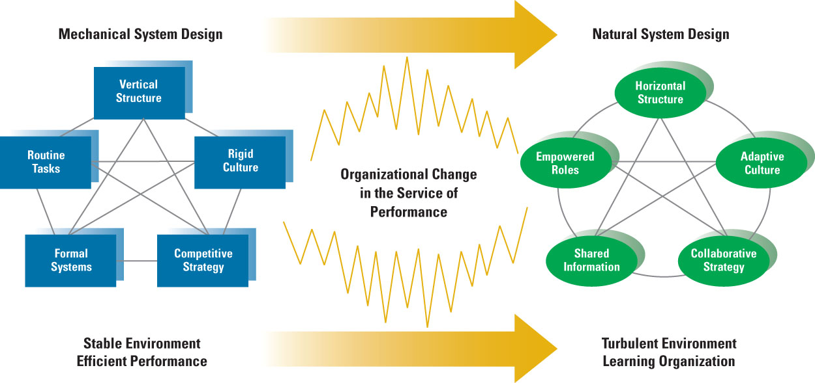
Two Organization Design Approaches
0

Slide 47
EXERCISE LEARNING TEST 1.
1. The definition of "organization" is:
a. A goal-directed entity that has members who set goals and achieve them through strategic planning.
b. An entity with identifiable permanent boundaries.
c. A social entity that is goal-directed, has a deliberately-structured activity system, and a permeable boundary.
d. A business that performs work activities and contributes to its society by employing people.
2. Scientific management, pioneered by Frederick Taylor, claimed that decisions about organizations and job design should be based on:
a. Precise, scientific procedures after careful study of individual situations.
b. The insights of practitioners.
c. Leadership, motivation, and human resource management.
d. Management theory.

Slide 48
EXERCISE LEARNING TEST 1.
3. Organization is born as result of the:
a. Economies of specialisation
b. Economies of learning
c. Economies of scale production
d. Division of labour
4. The importance of organizations includes all of the following concepts excepts:
a. Bring togheter resources to achieve desidered goals and outcomes.
b. Establishing important relationships whit the government.
c. Facilitate innovation.
d. Create value for owners, customers, and employees.

Slide 49
EXERCISE LEARNING TEST 1.
5. The 385-page book that McDonald’s uses to describe all rules and procedures in each of its stores best represents which of the following dimensions:
a. Learning theory.
b. Sequential interdependence.
c. Formalization.
d. Specialization.
6. The degree to which organizational tasks are subdivided into separate jobs is referred to as
a. formalization.
b. centralization.
c. professionalism.
d. specialization.

